Slide 1
Binary Trees
Chapter 6

Slide 2
Objectives
Trees, Binary Trees, and Binary Search Trees
Tree Traversal
Implementing Binary Trees
Binary Search Tree
Insertion
Deletion
Balancing a Tree
Simple tree balancing
The DSW Algorithm (*)
AVL Trees
Heaps
Polish Notation and Expression Trees (*)
Reading at home
Notes:
Note: (*) Means that students are required to understand essential features only (the problem explanation, definitions, the outline of algorithms…), not in details.

Slide 3
Deletion on Binary Search Trees
There are three cases of deleting a node from the binary search tree
The node is a leaf (it has no children)
The node has one child
The node has two children
Don't break the ordering property of the tree

Slide 4
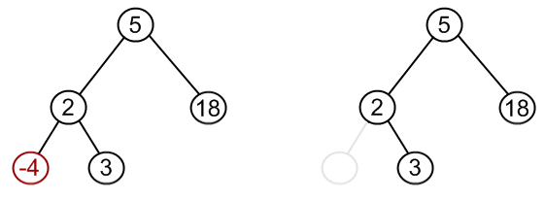
Deleting a leaf (node has no children)

Slide 5
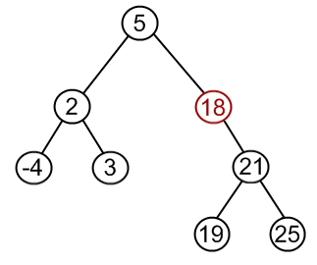
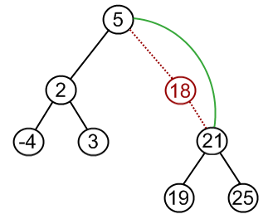
Deleting a node with one child

Slide 6
For both of these cases
If the node doesn’t have left child
Point the node to its right child
We don’t care about the right child
If the node doesn’t have right child
Point the node to its left child
We don’t care about left child
Later on, point the parent (left or right) to the node
Left or right, depends on the node was left or right child of this parent

Slide 7
If the node doesn’t have a right child
Case: Doesn’t have right child
And the left child is not null
(It has one child)
Case: Doesn’t have right child
And the left child is null
(It is a leave)
prev
prev
7
7
p
p
node
3
9
node
3
9
8
null
null
null
We operate with both cases in the same way

Slide 8
If the node doesn’t have a left child
Case: Doesn’t have left child
And the right child is not null
(It has one child)
Case: Doesn’t have left child
And the right child is null
(It is a leave)
prev
prev
7
7
p
p
node
3
9
node
3
9
null
null
null
8
We operate with both cases in the same way

Slide 9
Deleting a node with two children
Delete by Merging
Delete by Copying

Slide 10
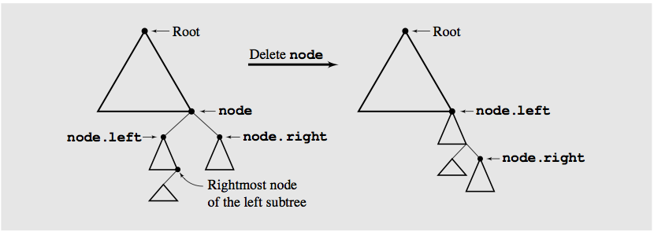
Delete by Merging
Making one tree out of the two substrees of the node
Now it has only one child (delete this using previous algo)
And then attaching it to the node’s parent substree is called deleting by merging

Slide 11
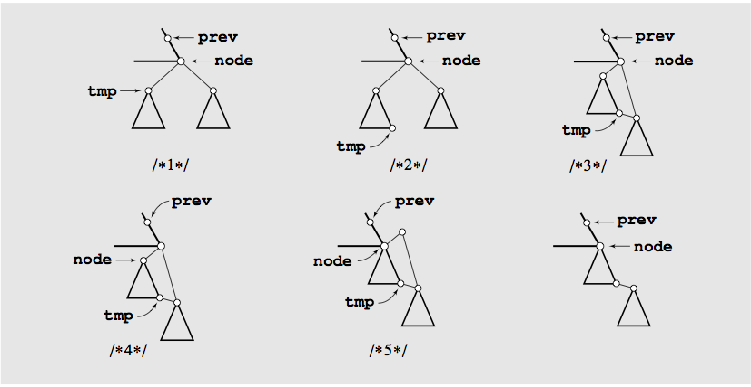
Delete by merging details

Slide 12
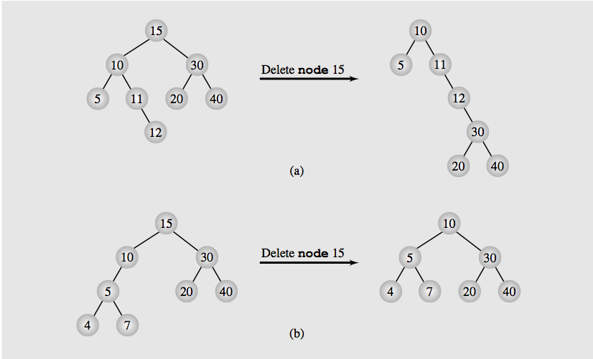
Height of a tree

Slide 13
Delete by Copying
If the node has two children, the problem can be reduced to
The node is a leaf
The node has only one nonempty child.
Solution: Replace the key being deleted with its immediate predecessor (or successor)
A key’s predecessor is the key in the right most node in the left substree

Slide 14
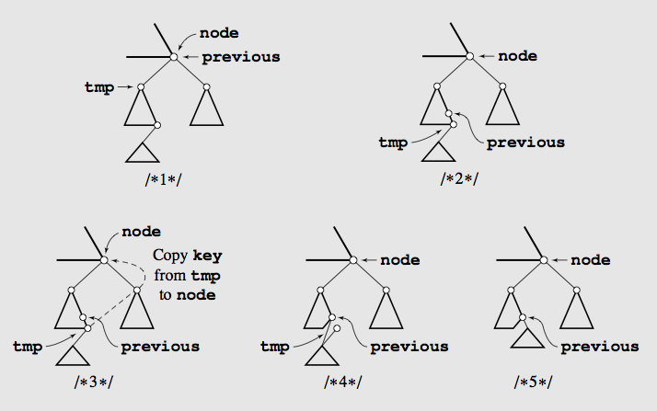
Delete by Copying

Slide 15
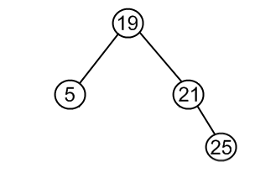
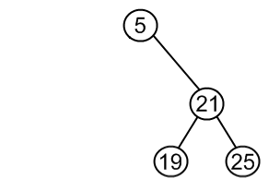
Details explanation
Same set of values may be represented as different binary-search trees.
Transforming the first into the second
Choose minimum element from the right subtree (19)
Replace 5 by 19
Hang 5 as left child

Slide 16
Details explanation
The same approach can be used to remove a node, which has two children
Find a minimum value on the right subtree (or the maximum on the left subtree)
Replace value of the node to be removed with found minimum. Now right subtree contains a duplicate
Apply remove to the right subtree to remove duplicate
Note also that the minimum node will not have left subchild
So the deletion is first/or second case (delete leaf, or delete node with one child) only.

Slide 17
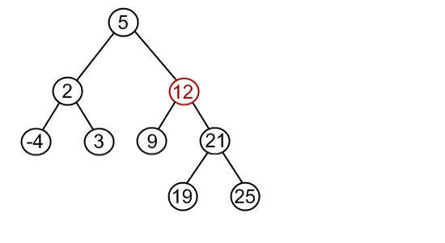
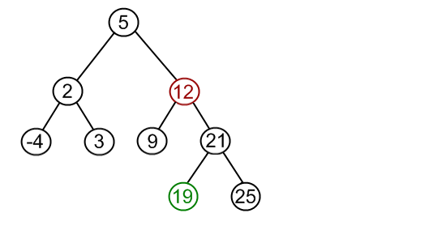
Delete by Copying

Slide 18
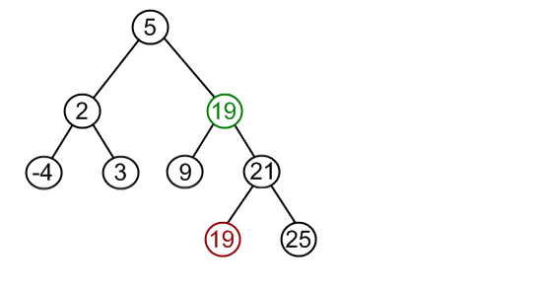
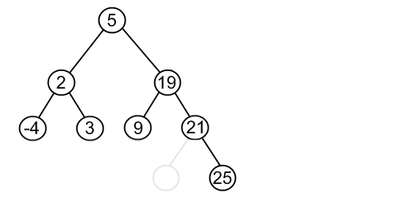
Delete by Copying

Slide 19
Example
prev
15
p
19
9
previous
node
17
18
4
12
tmp
3
null
13
Find the right most (largest) of the left subtree of the node, and its previous

Slide 20
Example
prev
15
p
19
4
previous
node
17
18
4
12
tmp
3
null
13
Find the right most (largest) of the left subtree of the node, and its previous
Copy the info of the largest node of this left subtree to the deleted node

Slide 21
Example
prev
15
p
19
4
previous
node
17
18
4
12
tmp
3
null
13
Find the right most (largest) of the left subtree of the node, and its previous
Copy the info of the largest node of this left subtree to the deleted node
If the left child’s right subtree is null (previous=node)
True: previous.left=temp.left;
False : Previous.left = temp.right

Slide 22
Example
prev
15
p
19
4
previous
node
17
18
12
3
13
Find the right most (largest) of the left subtree of the node, and its previous
Copy the info of the largest node of this left subtree to the deleted node
If the left child’s right subtree is null (previous=node)
True: previous.left=temp.left;
False : Previous.left = temp.right

Slide 23
Example
prev
15
p
19
9
previous
node
tmp
17
18
4
12
3
6
13
Find the right most (largest) of the left subtree of the node, and its previous
5
8
7

Slide 24
Example
prev
15
p
19
9
node
17
18
4
12
previous
3
6
13
tmp
Find the right most (largest) of the left subtree of the node, and its previous
5
8
7

Slide 25
Example
prev
15
p
19
8
node
17
18
4
12
previous
3
6
13
tmp
Find the right most (largest) of the left subtree of the node, and its previous
Copy the info of the largest node of this left subtree to the deleted node
5
8
7

Slide 26
Example
prev
15
p
19
8
node
17
18
4
12
previous
3
6
13
tmp
Find the right most (largest) of the left subtree of the node, and its previous
Copy the info of the largest node of this left subtree to the deleted node
If the left child’s right subtree is null
True: previous.left=temp.left;
False : Previous.right = temp.left
5
8
7

Slide 27
Example
prev
15
p
19
8
node
17
18
4
12
3
6
13
Find the right most (largest) of the left subtree of the node, and its previous
Copy the info of the largest node of this left subtree to the deleted node
If the left child’s right subtree is null
True: previous.right=temp.right;
False : Previous.right = temp.left
5
7

Slide 28
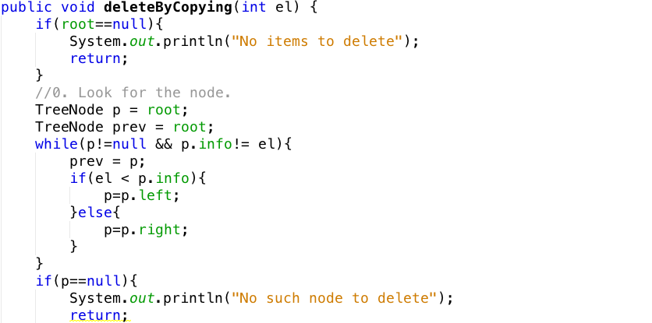
Find the node and its parent

Slide 29
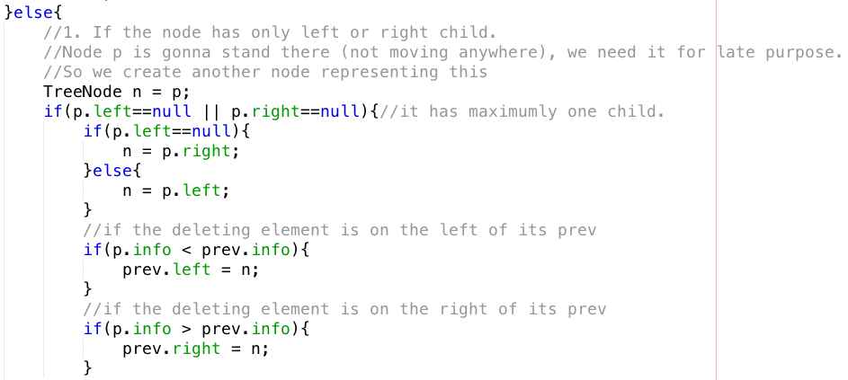
If the node is a leave or has one child

Slide 30
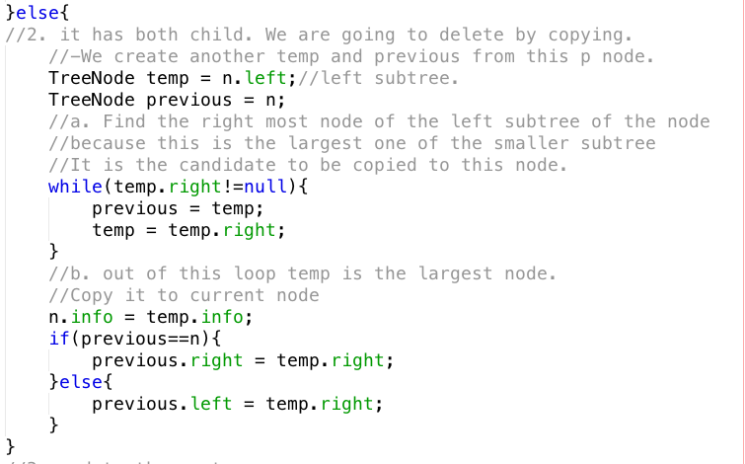
If the node has both children

Slide 31

Update root if deleting node is the root

Slide 32
Balancing Binary search trees

Slide 33
About balancing BST
What is a balanced tree in general?
No leaf is more than a certain amount farther from the root than any other
This is vague but, no matter the variation, a balanced tree should maintain the O(log n) invariant for most operations
Concrete definitions
Is height-balanced or balanced if the difference in height of both subtrees of any node in the tree is either zero or one
Is considered perfectly balanced if it is balanced and all leaves are to be found on one level or two levels

Slide 34
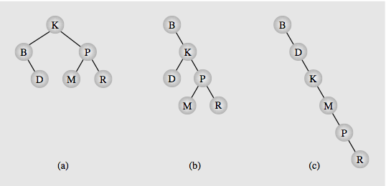
Why need to balance?
The best BST (shortest BST)
The worst BST

Slide 35
Simple balance algorithm
Copy all tree nodes to an array
Sort the array
Clear the tree
Call the balance() method
Insert the middle of the array
Recursively insert middle of the left part of the previous array
Recursively insert middle of the right part of the previous array segment

Slide 36
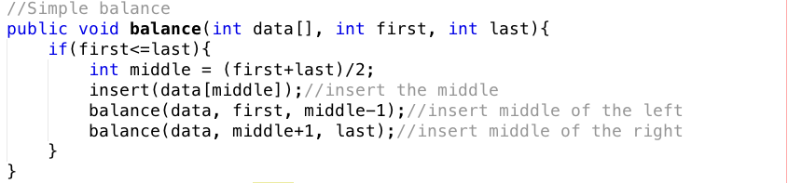
Simple balance algorithm Implementation

Slide 37
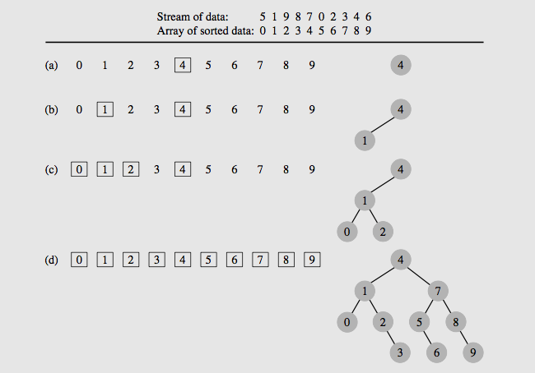
Example

Slide 38
DSW Balancing Algorithms
The simple balance algo’s issues
Requires an array to be sorted before balancing
Requires clear the old tree and build a new one every balancing is called
DSW: Day, Stout, Warren
Requires little additional intermediate variables and use no sorting algorithm
The building block for tree transformations is the rotation
There are two types of rotation, left and right, which are symmetrical to one another

Slide 39
Right rotation

Slide 40
Right rotation
Gr
Pr
Ch
R
P
Q

Slide 41
Right rotation
Gr
Pr
Ch
R
P
Q

Slide 42
Right rotation
Gr
Pr
Ch
P
Q
R

Slide 43
Right rotation
Gr
Ch
Pr
P
Q
R

Slide 44
Right rotation
- Ch has 3 children
- Q: Right child of Ch must be smaller than Pr
- Q: must be larger than Ch (right child of Ch)
- Q: is qualified to be left child of Pr
Gr
Ch
Pr
P
Q
R

Slide 45
Right rotation
Gr
Ch
Pr
P
Q
R

Slide 46
Right rotation
Gr
Ch
Pr
P
Q
R

Slide 47
Right rotation
Gr
Ch
Pr
P
R
Q

Slide 48
Right rotation
Gr
Ch
Pr
P
R
Q

Slide 49
x2 = x1.left
r2 = x2.right
x1.left = r2
x2
x1
x1
P
x2
r1
r1
r2
P
r2
x1.left = r2
x2
x1
x2.parent = x1.parent
X2.parent.child=x2
X1.parent = x2
P
r1
r2

Slide 50
Left rotation

Slide 51
Left rotation
Gr
Ch
Pr
P
R
Q

Slide 52
Left rotation
Gr
Q: is qualified to be right child of Ch.
Q > Ch
Q < Pr
Ch
Pr
P
R
Q

Slide 53
Left rotation
Gr
Ch
Pr
P
Q
R

Slide 54
Left rotation
Gr
Ch
Pr
P
Q
R

Slide 55
Left rotation
Gr
Ch
Pr
P
Q
R

Slide 56
Left rotation
Gr
Ch
Pr
P
Q
R

Slide 57
Left rotation
Gr
Pr
Ch
P
Q
R

Slide 58
Left rotation
Gr
Pr
Ch
R
P
Q

Slide 59
Left rotation
Gr
Pr
Ch
R
P
Q

Slide 60
x1
x2
x1
x2
l1
l1
l2
R
R
l2
x1.right = l2
l2.parent = x1
x2 = x1.right
l2 = x2.left
x2
x2.left = x1
x1
x2.parent = x1.parent
x2.parent.child = x2
x1.parent = x2
R
l1
l2

Slide 61
Left rotation
Left rotation is the reverse of right rotation.

Slide 62
DSW Algo
DSW consists of two steps
1. Transform tree into link list like tree (backbone or vine)
2. Rotating every second node of the backbone about its parent

Slide 63
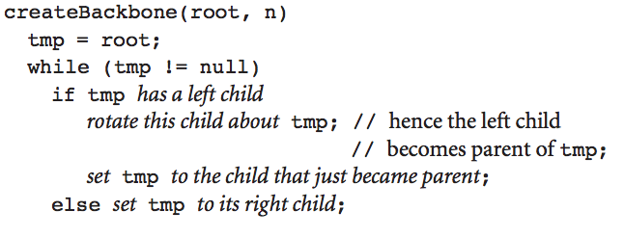
Step 1. Creating the backbone

Slide 64
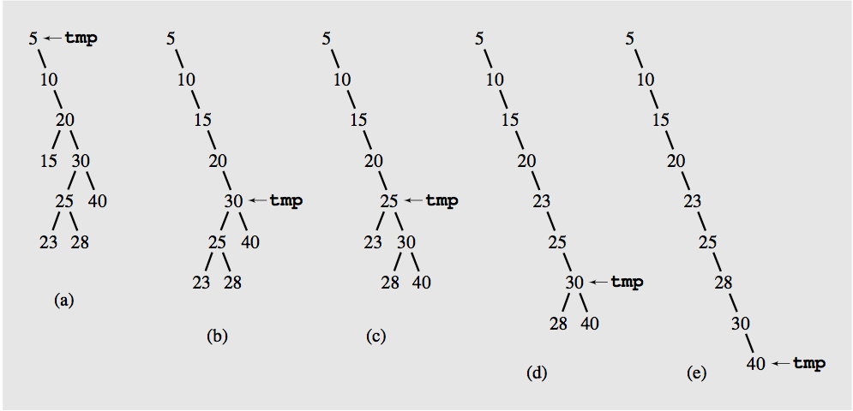
Step 1. Creating the backbone

Slide 65
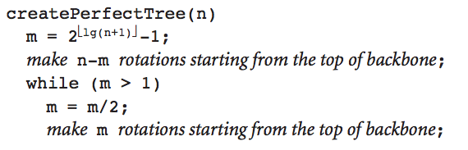
Step 2. Building perfectly balanced tree
Every second node down to certain point is rotated about its parent
The first pass may not reach the end of the backbone:
It’s used to account for the difference between the number n of nodes in the current tree and the number 2 powers of upper round of lg(n+1) then – 1

Slide 66
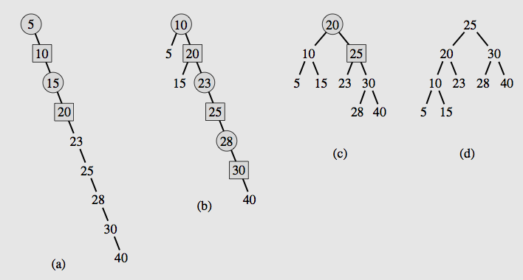
Step 2. Building perfectly balanced tree

Slide 67
Henry: more tests
1 2 3
1 2 3 4 5 6 7
1 2 3 4 5 6 7 8 9
1 2 3 4
1 2 3 4 5

Slide 68
Objectives
Trees, Binary Trees, and Binary Search Trees
Tree Traversal
Implementing Binary Trees
Binary Search Tree
Insertion
Deletion
Balancing a Tree
The DSW Algorithm (*)
AVL Trees
Heaps
Polish Notation and Expression Trees (*)
Reading at home
Notes:
Note: (*) Means that students are required to understand essential features only (the problem explanation, definitions, the outline of algorithms…), not in details.

